Slide 1

Reserve your table
Team members:
B. Navaneeth (1602-16-737-026)
Y. Prashanth(1602-16-737-030)
k. Divya (1602-16-737-011)

Slide 2

Review 1
Problem Statement
Solution
Use-cases
Technology Stack

Slide 3
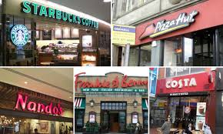
Problem statement
Facing trouble in choosing and booking a restaurant

Slide 4
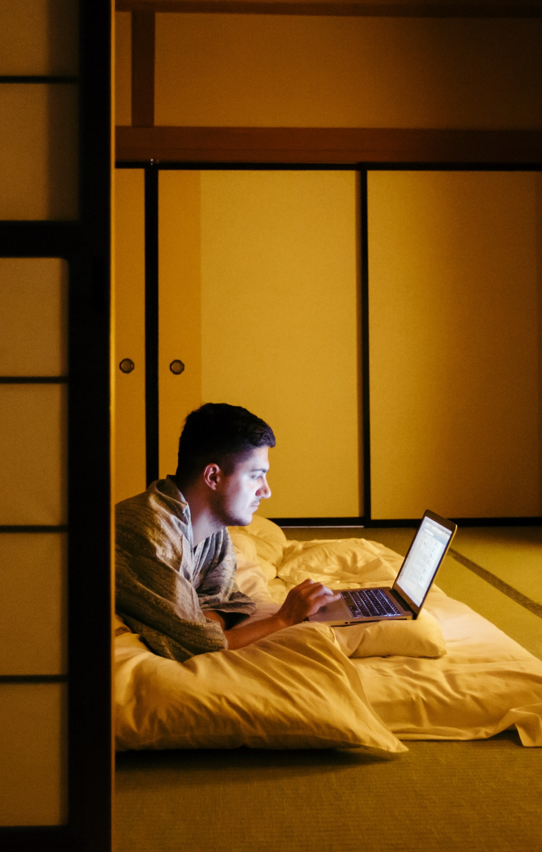
SOLUTION: An app to select a restaurant which suits your taste and choice. To reserve a table early
Reduces cost of booking at peak times
Select restaurant which suits your taste
Order food the way you want it.

Slide 5
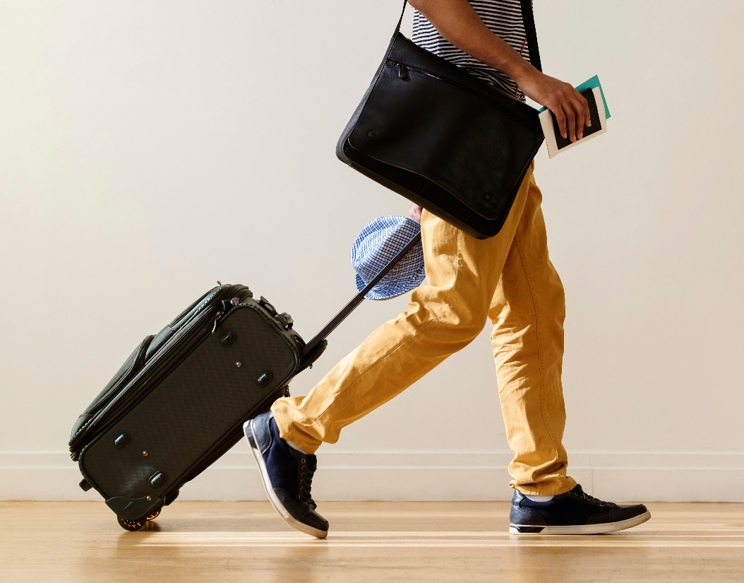
Use cases:
Login through email
Set date, time and find restaurants
Find food menu and restaurant reviews
Book your table and food
Payment for food
Cancel your booking

Slide 6
TECHNOLOGY STack
Android Studio
Database connectivity using json, jdbc

Slide 7
THANK YOU

